Slide 1
Understanding Third-Party Wheeling and How to Enable

Slide 3
Day 1: Understanding Third-Party Wheeling and How to Enable
Welcome, introduction to participants & overview of the training agenda – Rashid Khan (15 min)
What is wheeling, importance & benefits – Josh Dippenaar (30min)
Barriers - Bernhard Teuteberg (30min)
Toolkits - Rashid Khan & Bernhard Teuteberg (30min)
Steps to enable wheeling in the municipality – Josh Dippenaar (15 min)
Staff buy in – Josh Dippenaar (15 min)
Municipal guideline – Rashid Khan (45 min)
Council approval – Frans Brandow (30 min)
Q&A – All (30 min)

Slide 4
Day 2: Technical Deep Dive
Wheeling tariffs – Josh Dippenaar
Wheeling agreements – Bernhard Teuteberg
Metering and billing system – Rashid Khan
How to open or pilot wheeling – Frans Brandow
Q&A - All
Recap of key takeaways from the workshop
Closing remarks and acknowledgments
Notes:
1. Metering and Billing System Metering and billing systems play a crucial role in ensuring that energy consumption is accurately recorded, invoiced, and managed. By implementing modern systems, utility companies can ensure accurate energy consumption data, leading to transparent billing for the end consumers and improved revenue management for the providers.
2. Importance Of Accurate Metering In Wheeling Accurate metering in wheeling (the process of transferring electric energy from a source to a distribution network) is vital to ensure that energy producers are properly compensated, and end-users are billed correctly. Accurate metering eliminates discrepancies in energy consumption data, fostering trust between stakeholders and ensuring efficient energy distribution without losses.
3. Introduction To Advanced Metering Infrastructure (AMI) Advanced Metering Infrastructure (AMI) refers to an integrated system of smart meters, communication networks, and data management systems. It allows for real-time data collection, two-way communication between utilities and consumers, and offers a plethora of benefits such as demand response, outage detection, and real-time energy consumption insights.
4. Data Exchange and Management for Seamless Operations For utility operations to run seamlessly, there needs to be efficient data exchange and management. By leveraging advanced platforms and technologies, utilities can ensure that data from meters, billing systems, and other sources is consolidated, processed, and distributed effectively. This facilitates timely billing, accurate forecasting, and better energy management.
5. Understanding the Role of IT in Wheeling Operations Information Technology (IT) plays an instrumental role in wheeling operations. From the deployment of intelligent sensors and meters to the use of sophisticated software for data analytics and visualization, IT enables accurate monitoring, prediction, and management of energy flow. In the realm of wheeling, IT ensures the smooth transfer of energy, optimal network utilization, and efficient communication between different operational nodes.

Slide 5
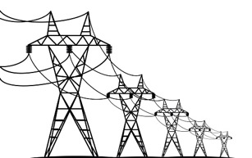
Introduction: Wheeling
Electricity wheeling refers to the delivery of electrical energy over the electricity network from generators to customers.
Electricity
IPP
Municipality
Off-taker
Third-party networks
Power Purchase Agreement
Third-party wheeling is a financial transaction where, through a bi-lateral or multi-lateral transaction, a generator sells their generated electrical energy to another party, using the existing distribution or transmission infrastructure of a Licensee.

Slide 6
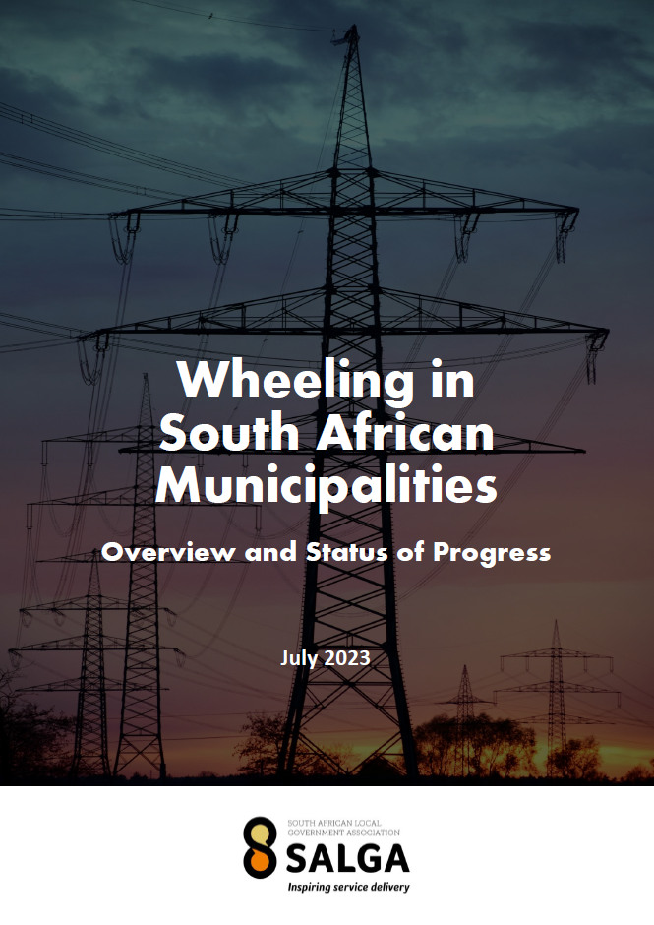
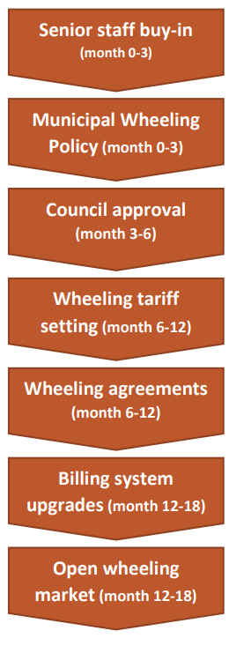
SALGA Status of Wheeling Report 2023
Steps to wheel
Available: https://www.sseg.org.za/salga-status-of-wheeling-report-2023/

Slide 7
Steps for a municipality to take to establish & operate third-party energy wheeling
1
2
3
4
5
Internal Workshop & Buy-In
Gather key stakeholders from legal, finance, electricity, metering and economic development departments.
Develop Tariffs & Guidelines
Define guidelines, participation criteria, procedures and technical requirements.
Council Approval
Obtain official approval from Municipality in accordance with municipal regulations.
Public Participation
If required engage the public for feedback and input.
Review and adjust policies based on feedback.
Submit Tariffs to NERSA
For review and approval.
6
7
8
9
10
11
Approved Policy & Tariff
Finalise the policy and guidelines. Obtain final approval from relevant authorities. Gazette the policy & tariff for implementation.
Customize Agreements
Review and adapt agreements for municipality’s needs. Seek feedback and legal review. Finalise agreement for implementation.
Prepare / Upgrade Billing System
Assess existing billing and metering systems. Consider smart metering solutions. Procure & integrate. Train personnel.
Open Wheeling Market
Announce service to public. Simplify application process. Set up user support. Monitor & Review periodically.
Tariff Approval
Get approval as part of budget process.
Align tariff with the financial plan.
Testing Project
Pilot the wheeling service with a small group within set time frame. Monitor & gather feedback.
Adjust based on lesson learned.

Slide 8
There are many direct and indirect benefits to implementing wheeling
Wheeling is an important steppingstone to a more open electricity market.
Extensive modelling has shown that it can be implemented in a surplus-neutral way, to ensure municipal revenue streams are protected.
The best way to understand this is that instead of “wheeling” Eskom electricity like the municipality currently does, you would also allow private users to wheel over your network and charge the same surplus as you do with Eskom energy.
There is a legislative responsibility to allow access to the network to third parties.
There are some steps involved with the implementation, but many resources have been developed to assist, and there is support available.

Slide 9
Barriers
Supposed lack of demand for wheeling
No national wheeling framework
Concern over revenue protection
Lack of accurate cost of supply studies
Not enough capacity at municipal level to implement
Complicated agreements are required
Eskom supply agreements deposit updating
Metering and admin complexities
Lack of grid capacity
Municipal debt

Slide 10
Wheeling Roadblocks
What are the things that are stopping wheeling from being implemented at municipalities?
Bernhard Teuteberg – DOI – Western Cape Government
Summary of work done so far and potential next steps
There is a clear need for the implementation of wheeling at municipal level, but progress has been “frustratingly” slow for the private sector users that are waiting for it. There are however very good reasons for the lack of speed in the form of several key bottlenecks in the system.
This presentation will cover some of the major ones identified by WCG and some potential solutions, but it is clear that these are not the only bottlenecks and further work is required.

Slide 11
PROBLEM: Wheeling demand seems to be limited to multinationals with carbon targets, or high energy users
STATUS
Partially solved
Engagement in the WCG (through SEA) showed that most of our “high” energy users are not even aware of wheeling, but in the areas where municipalities have been proactive, there is much more interest. Also, some interesting products being built by private sector
NEXT STEP: We can be proactive in responding to a need that some users do not even know they have yet – “if you build it they will come”
Supposed lack of
demand for wheeling
SOLUTION: Engage with private sector to find out what they really want

Slide 12
Not that many very large users in the WC
9% of large businesses at risk of insolvency due to load shedding
98% of businesses had generators, which give energy at 4-5x the cost
Municipal sales of electricity expected to decline even though final energy use increases (Embedded generation, fuel switching)
Embedded generation expected to continue to grow at large rates
Wheeling expected to see exponential growth over time
Municipal capacity is severely constrained
Cost-reflective tariffs are key
Revenue protection
Continued
Key outputs

Slide 13
PROBLEM: Lack of a national guiding principles, and therefore no approval of tariffs from NERSA
STATUS
Being solved
This is being discussed and developed at NECOM-9, and several key people are working on solutions. It’s important that a national framework provides guidance without being restrictive though
NEXT STEP: Publish a national framework for comment
National wheeling
framework
SOLUTION: Develop national wheeling framework

Slide 14
PROBLEM: Municipalities are wary of the potential revenue loss that could be associated with the implementation of wheeling on their networks.
STATUS
Mostly solved
WCG funded the development of a municipal revenue tool for the implementation of wheeling (SEA).
The tool initially focused on two WC municipalities and showed that revenue neutral tariffs were possible, and that there is potential for significant positive impact on local investment.
NEXT STEP: Use tool in training and distribute wider
Revenue protection
SOLUTION: Build a revenue model that calculates the potential impact of allowing electricity wheeling on to specific municipal networks.

Slide 15
Revenue neutral tariffs are possible with careful design
Additional admin costs can be leveraged on the customer
Wind energy tends to be more viable due to higher production in peak periods, but solar can work too
Business case must be viable for ALL three parties
Future Eskom prices are critical for the viability of wheeling
Various socio-economic benefits (jobs, local investment, cost savings, risk mitigation, clean energy commitments, municipal trust)
Important to start using the model more widely
Revenue protection
Continued
Key outputs

Slide 16
PROBLEM: Many cost of supply studies have not been updated sufficiently, or are not properly cost-reflective as of yet
STATUS
Partially solved
Several CoS studies were funded last year, and there is good training available to ensure high quality deliverables
NEXT STEP: Ensure more municipalities have high-quality, wheeling-ready CoS studies
Cost of Supply
Studies
SOLUTION: Accurate and complete cost-of-supply studies are critical to the calculation of fair wheeling charges, and should be a high priority for municipalities

Slide 17
PROBLEM: Municipalities technical departments are incredibly capacity constrained with the current load shedding situation, and there is a lack of specific training related to wheeling
STATUS
Partially solved
Lots of new toolkits and resources have been developed and more training being offered.
However, this might not be enough – you still need technical people at the municipality to have some time available
NEXT STEP: Wider distribution of training materials, and looking at potential solutions for the time factor
Municipal capacity
SOLUTION: Increase capacity through training, standardization of documents and collaboration

Slide 18
PROBLEM: The implementation of wheeling requires complex legal documents that require specific techo-legal expertise usually not present in non-metro municipalities
STATUS
Partially solved
Standardized documents have been developed by Pegasys (WCG funded) and will be released as part of the WCG Wheeling Toolkit
NEXT STEP: Release the toolkit
Complicated
agreements
SOLUTION: Develop standardized documents for the UoS and associated agreements

Slide 19
PROBLEM: Wheeling from outside the municipality often (always?) requires a change in the Eskom supply agreement, which updates the deposit requirements. The new deposit can be very significant (R100m+)
STATUS
Potentially partly solved
Ekurhuleni have made some breakthroughs with Eskom, and instruction has come from NECOM to solve this. However, still no official communication from Eskom (on the way hopefully…) and will only help in specific cases
NEXT STEP: Wait for the official comms from Eskom and see if this solves your specific problem (unlikely to help in cases where NMD is increased)
Eskom supply
Agreement deposits
SOLUTION: Get an official answer from Eskom

Slide 20
PROBLEM: Many municipalities do not have the required billing and metering systems to facilitate wheeling transactions
STATUS
Early stages for most
Municipalities do not necessarily need complex systems to run pilots, but it’s good to start thinking about this now
There are some potential technology solutions out there for the longer term
NEXT STEP: Copy approaches that successful municipalities have used to skip the pilot step
Metering / Admin
complexities
SOLUTION: The technology needed to solve this is not particularly complex, but integration into existing billing systems might be

Slide 21
PROBLEM: It looks like all the good sites have been used / reserved at transmission level – so hard to get big projects connected currently
STATUS
Needs more thought
A lot of the reserved sites are hoping to wheel – mostly Eskom-Eskom, but multinationals often want to wheel into municipalities.
There is also grid capacity available in municipalities, but how much?
Is there space for private transmission?
NEXT STEP: Grid infrastructure is going to need a lot of work in the coming years
Grid capacity
SOLUTION: Not an easy one to solve, but there some important points to consider

Slide 22
PROBLEM: Eskom very unlikely to allow wheeling to municipalities with debt or not in good standing
STATUS
Being discussed
Some discussions are happening at NECOM level, but this forms part of a national problem that will need solving. It forms a key risk for long-term private deals and may inhibit the growth of wheeling
NEXT STEP: Unclear
Municipal debt
SOLUTION: If you know, please let us know

Slide 23
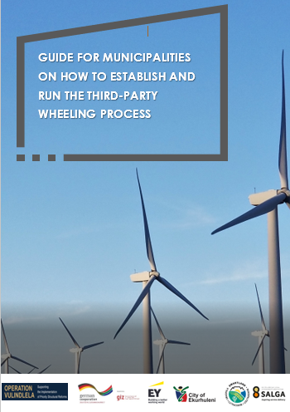
Resources under discussion
Western Cape Government toolkit
GIZ EY detailed guide to enable wheeling

Slide 24
Steps for a municipality to take to establish & operate third-party energy wheeling
01
Get senior staff buy-in – Wheeling requires inputs from many different departments in the municipality and will require a combined effort to develop to fruition.
02
Develop wheeling tariffs – Use the existing templates to prepare rules and tariffs.
03
Prepare a wheeling guideline – The wheeling guideline signals to the private market your intentions and a framework for wheeling.
04
Get council approval – Prepare a submission and present to council.
05
Apply to NERSA for approval of tariffs – Currently NERSA is not approving tariffs due to a lack of methodology, but this should not stop wheeling projects going ahead.
06
Customize wheeling agreements – Use existing templates and user guides.
07
Prepare / Upgrade billing system – Initial projects can be run on simple basis like Excel, but future billing systems should be prepared to incorporate wheeling transactions.
08
Pilot project – The municipality may decide to run a pilot project to test mechanisms and procedures.
09
Open wheeling market – Open the wheeling market to the public.

Slide 25
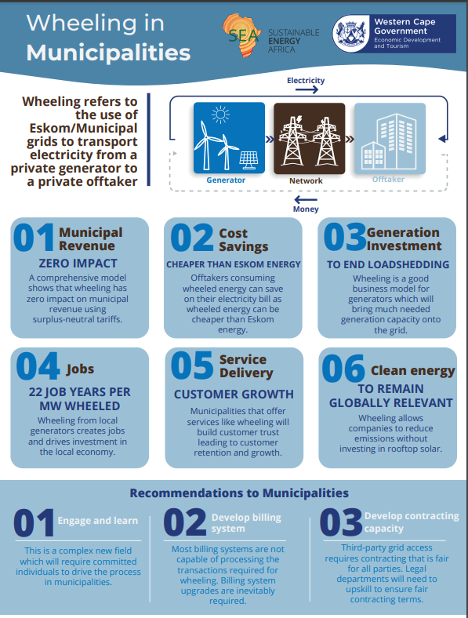
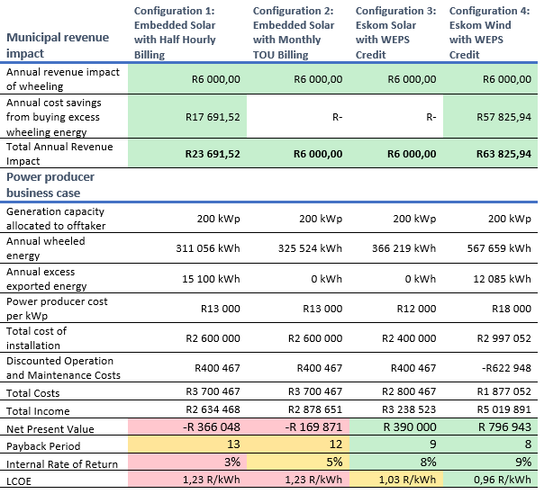
Get senior staff buy-in
Use the infographic and video provided to frame the opportunity.
Use the information in the toolkit to estimate effort / costs required to implement.
Use the municipal revenue study Excel tool to prove no negative revenue impact.
Get buy-in of the following key departments: Legal, Finance, Billing, Electro-technical.

Slide 26
Infographic developed with Sustainable Energy Africa

Slide 28
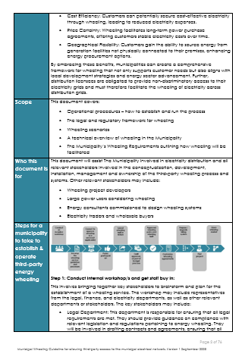
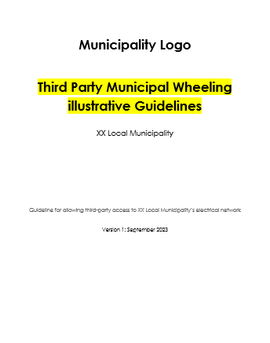
Prepare a wheeling guideline

Slide 29
Scenario 1
Munic network
Amended Supply Agreement
Connection and Use of Systems Agreement (+ Wheeling Annex)
Eskom network
Amended Supply Agreement
Smart Meter @ POD
Check Smart Meter @ POD
IPP:
Invoice from Eskom to Munic
Customer & Off taker
Tariff: Eskom tariff & WEPS (credit) for energy wheeled
Invoice from Munic to Customer
Tariff: Wheeling tariff / Muni tariff & WEPS credit:
100% energy supplied to connection point incl. losses as part of wheeling costs
Credit for green energy imported @ WEPS rate
Wheeling charges: Administration charge and affordability subsidy rebate
Smart Meter @ Generator
Power Purchase Agreement
Munic Smart Meter @ Customer
Contractual Arrangement
Invoice from Generator to Customer
Actual Electricity Flow
Contracted Electricity Flow
Tariff: As agreed with customer in PPA
Invoicing And Payment Flow

Slide 30
Scenario 1 + Trader
Munic network
Amended Supply Agreement
Connection and Use of Systems Agreement (+ Wheeling Annex)
Eskom network
Amended Supply Agreement
Smart Meter @ POD
Check Smart Meter @ POD
IPP:
Invoice from Eskom to Munic
Customer & Off taker
Tariff: Eskom tariff & WEPS (credit) for energy wheeled
Invoice from Munic to Customer
Tariff: Wheeling tariff / Muni tariff & WEPS credit:
100% energy supplied to connection point incl. losses as part of wheeling costs
Credit for green energy imported @ WEPS rate
Wheeling charges: Administration charge and affordability subsidy rebate
Use of Systems Agreement
Smart Meter @ Generator
Munic Smart Meter @ Customer
Power Purchase Agreement
Energy Trader
Power Purchase Agreement
Contractual Arrangement
Actual Electricity Flow
Contracted Electricity Flow
Invoice from Generator to Trader
Invoice from Trader to Customer
Invoicing And Payment Flow
Tariff: As agreed with customer in PPA
Tariff: As agreed with customer in PPA + Trading fee

Slide 31
Scenario 2
Munic network
Connection and Use of Systems Agreement (+ Wheeling Annex)
Amended Supply Agreement
Smart Meter @ Point of Supply
IPP:
Customer & Off taker
Invoice from Munic to Customer
Tariff: Wheeling tariff / Muni tariff & WEPS credit:
100% energy supplied to connection point incl. losses as part of wheeling costs
Credit for green energy imported @ WEPS rate
Wheeling charges: Administration charge and affordability subsidy rebate
Smart Meter @ Generator
Power Purchase Agreement
Munic Smart Meter @ Customer
Contractual Arrangement
Invoice from Generator to Customer
Actual Electricity Flow
Contracted Electricity Flow
Tariff: As agreed with customer in PPA
Invoicing And Payment Flow

Slide 32
Scenario 2 + Trader
Munic network
Connection and Use of Systems Agreement (+ Wheeling Annex)
Amended Supply Agreement
Smart Meter @ Point of Supply
IPP:
Customer & Off taker
Invoice from Munic to Customer
Use of Systems Agreement
Tariff: Wheeling tariff / Muni tariff & WEPS credit:
100% energy supplied to connection point incl. losses as part of wheeling costs
Credit for green energy imported @ WEPS rate
Wheeling charges: Administration charge and affordability subsidy rebate
Smart Meter @ Generator
Munic Smart Meter @ Customer
Power Purchase Agreement
Energy Trader
Power Purchase Agreement
Contractual Arrangement
Actual Electricity Flow
Contracted Electricity Flow
Invoice from Generator to Trader
Invoice from Trader to Customer
Invoicing And Payment Flow
Tariff: As agreed with customer in PPA
Tariff: As agreed with customer in PPA + Trading fee

Slide 33
Scenario 3
Munic network
Eskom network
Amended Supply Agreement
Connection and Use of Systems Agreement (+ Wheeling Annex)
Amended Supply Agreement
Smart Meter @ POD
Check Smart Meter @ POD
IPP:
Invoice from Eskom to Munic
Customer & Off taker
Tariff: Eskom tariff & WEPS (credit) for energy wheeled
Invoice from Munic to Customer
Tariff: Wheeling tariff / Muni tariff & WEPS credit:
100% energy supplied to connection point incl. losses as part of wheeling costs
Credit for green energy imported @ WEPS rate
Wheeling charges: Administration charge and affordability subsidy rebate
Smart Meter @ Generator
Power Purchase Agreement
Munic Smart Meter @ Customer
Contractual Arrangement
Invoice from Generator to Customer
Actual Electricity Flow
Contracted Electricity Flow
Tariff: As agreed with customer in PPA
Invoicing And Payment Flow

Slide 34
Application Process
Municipal customer to obtain application form
Submit the completed application form/s and attachments
Decision provided, and if approved and applicable, municipality installs meter
Sign off all agreements
Complete the application form to partake in electricity wheeling
Municipality to obtain permission from other departments if required
Municipal inspection of installation, if applicable when there is generator
Tariff changed, and wheeling commences

Slide 35
Council approval
Industry driven as far back as 2019
This lead to putting policy and tariffs in place
The normal procedure as per MFMA was followed i.e. submit with annual provisional budget and also with final budget, the policy and wheeling tariff
Council approved since 2020-2021
Since then it is part of the budget approval process

Slide 36
Wheeling tariffs
Cost of supply studies and why
Current approach to setting wheeling tariffs
New cost of supply frameworks

Slide 37
Use-of-System Charges
Surplus-neutral wheeling UOS tariff = Retail tariff - WEPS
UOS “wheeling tariff”
Utility
retail
tariff
WEPS
credit

Slide 38
Scenario: Eskom-connected generator
Eskom
Municipality
Off-taker
100 kWh
Normal bill
-100*WEPS
Normal bill
-100*WEPS
Power producer

Slide 39
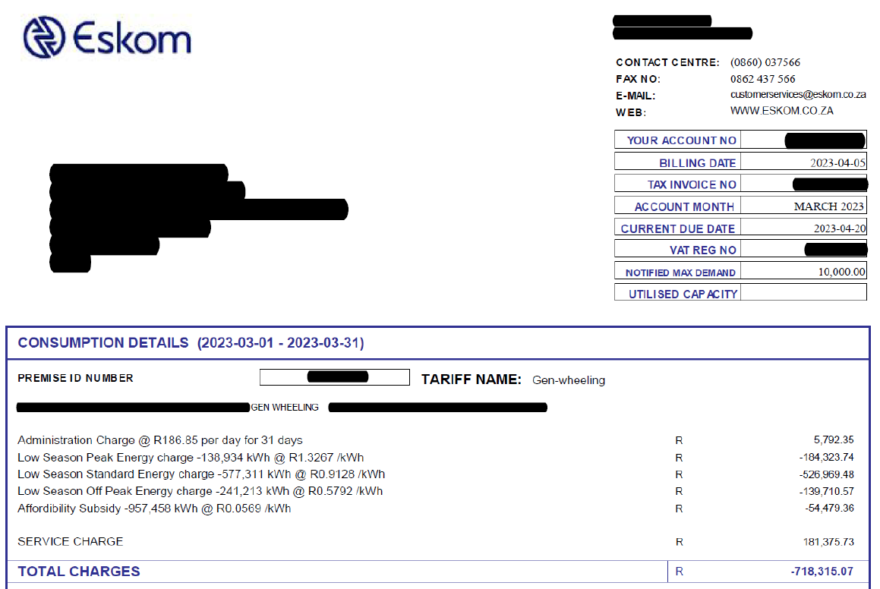
Example Eskom bill with wheeling credits

Slide 40
Scenario: Munic-connected generator
Eskom
Municipality
Off-taker
Power producer

Slide 41
Scenario: Munic-connected generator
Eskom
Municipality
Off-taker
-100 kWh
kWh purchases reduces by amount generated
Customer charged full retail price for all energy
100 kWh
-100*WEPS
Power producer

Slide 42
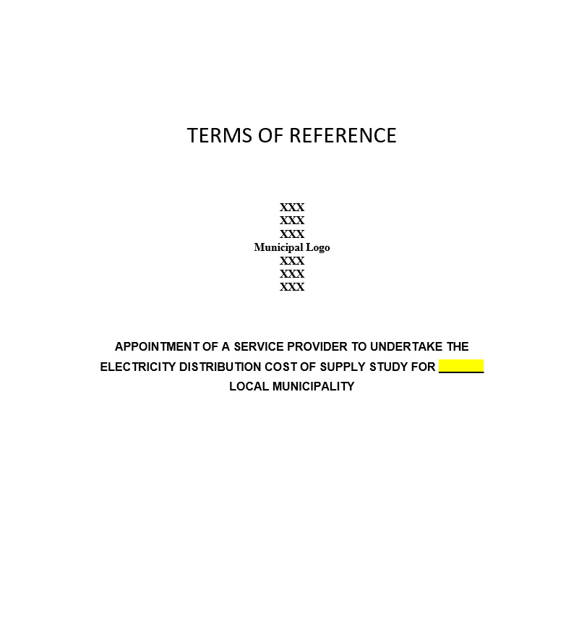
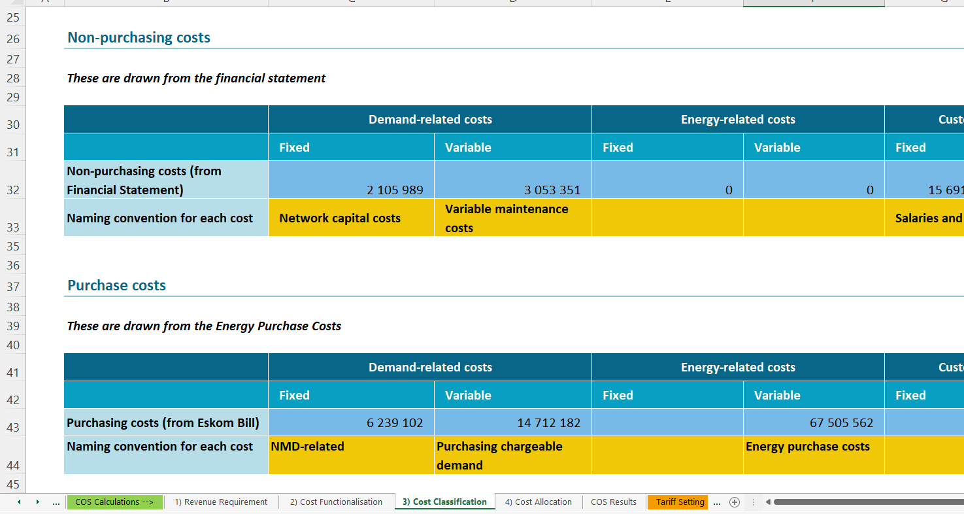
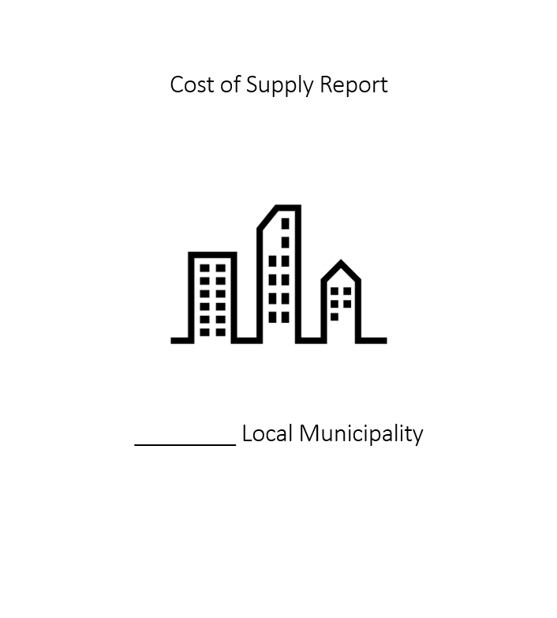
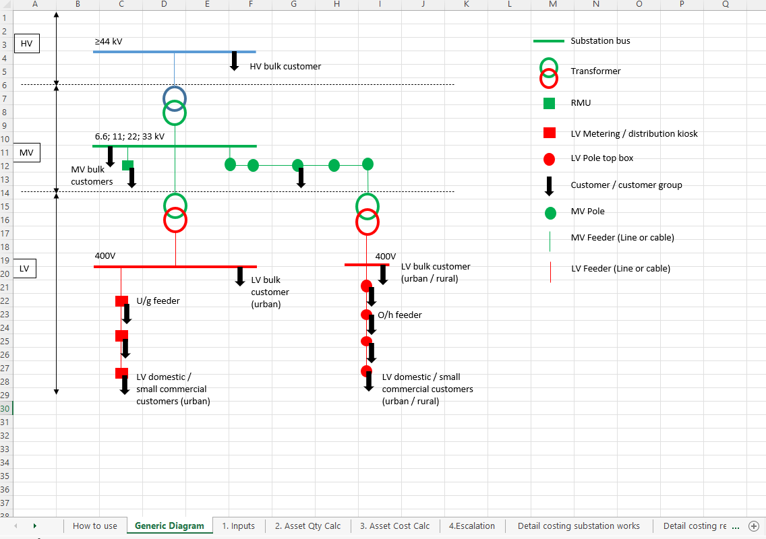
Cost of Supply Resources
COS Model
COS Consultant Template
Terms of Reference
COS Report Template
Asset Register
Proxy Tool
All available: https://www.sseg.org.za/cos/

Slide 43
Use-of-System Charges
UOS “wheeling tariff”
Utility
retail
tariff
WEPS
credit
Surplus-neutral wheeling UOS tariff = Retail tariff - WEPS

Slide 44
Wheeling agreements
• How to use guide
• Templates

Slide 45
Metering and billing system
Importance Of Accurate Metering In Wheeling
Introduction To Advanced Metering Infrastructure (AMI)
Data exchange and management for seamless operations
understanding the role of it in wheeling operations

Slide 46
Efficient Field Workforce, Workflow Management System
Integrate Departments
Effective demand management
Effective Fault / Ticket Management / CRM System
Other external data sources
Field Teams & Handheld Terminals
Digital Operations Centre
CRM and Plant Maintenance
Online customer query management and communications
Monitoring System &
APN
Integration Layers
Payments
Integration Layers
Customer Portal and Mobile App
AMI Network
Head-End System & Integration Layers
Meter Data Management System
Any-time Access To Customer Self-service Functionalities
ERP &Billing
Smart Meter
Remote restrictions
Meter data validations
Consolidated, secure and single master data historian
Accurate And Efficient Customer Bill Runs

Slide 47
Scenario 1
Munic network
Amended Supply Agreement
Connection and Use of Systems Agreement (+ Wheeling Annex)
Eskom network
Amended Supply Agreement
Smart Meter @ POD
Check Smart Meter @ POD
IPP:
Invoice from Eskom to Munic
Customer & Off taker
Tariff: Eskom tariff & WEPS (credit) for energy wheeled
Invoice from Munic to Customer
Tariff: Wheeling tariff / Muni tariff & WEPS credit:
100% energy supplied to connection point incl. losses as part of wheeling costs
Credit for green energy imported @ WEPS rate
Wheeling charges: Administration charge and affordability subsidy rebate
Smart Meter @ Generator
Power Purchase Agreement
Munic Smart Meter @ Customer
Contractual Arrangement
Invoice from Generator to Customer
Actual Electricity Flow
Contracted Electricity Flow
Tariff: As agreed with customer in PPA
Invoicing And Payment Flow

Slide 48
Metering
SANS 474:2018 (Ed. 2) Electricity metering – Standard requirements
Accreditation of meter workers, design, commissioning, calibration, instrument
transformers, maintenance – all regulated
Only utility meters used for primary billing

Slide 49
Data
NRS 049 Part 5-2: Automatic exchange of formal metering information betweensystems
Metering data only, no pricing or customer information
Based on IEC 61968-9, APPLICATION INTEGRATION AT ELECTRIC UTILITIES—SYSTEM INTERFACES FOR DISTRIBUTION MANAGEMENT—Part 9:Interfaces for Meter Reading and Control
Only totals on meter exchanged – can be audited
Privacy and authentication part of system design
Automatic or manual release of data for billing possible
Relies on existing technologies such as JSON, CAdES and mTLS

Slide 50
How to open or pilot wheeling
Task team between departments
Policies
Tariffs
By-laws
Contracts Vetted by own Legal Department
Finance Billing specifications mapped out and developed which will be aligned to the schedule of tariffs as well as the policies
Eskom contracts in place
Standard operating procedure for internal management (Guide as basis)
Application procedure in place – application form
Engage with all the potential generators/traders/off-takers in one session
Implement

Slide 51
Q & A

